Slide 1
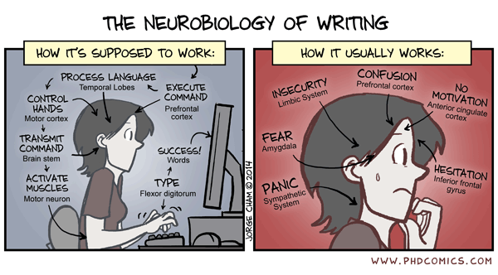

Writing papers
David Tscharke John Curtin School of Medical Research, ANU

Slide 2
What is a paper?
Abstract, Introduction, Results, Discussion, Method
Figures 1, 2, 3 and 4
A public record of a set of experiments
A collection of data and interpretation of what it means
A description of a new aspect of biology / medicine
A story of discovery
Based on what is known and your data

Slide 3
When do you start thinking about writing?
You feel like you have reached some kind of ending
Someone says ‘I think you have enough!’
The research has hit a brick wall
You are fed up with the project
Your abstract got a talk and it went down well
Your supervisor needs to renew the grant
Your scholarship is running out
Before you go in the lab

Slide 4
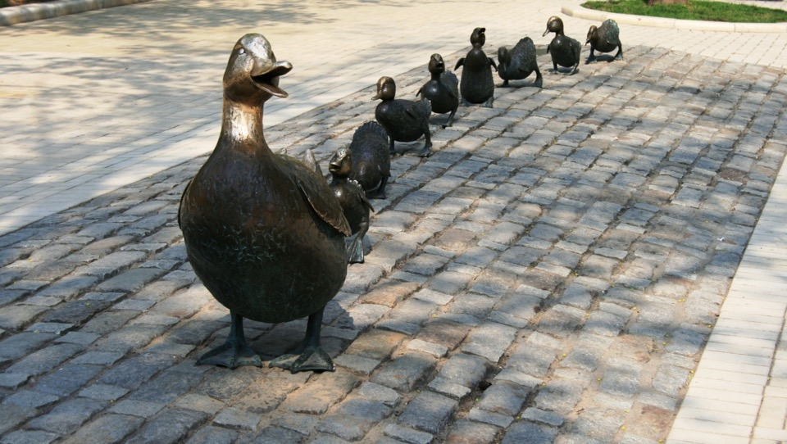
It’s never too early to get them in a row

Slide 5
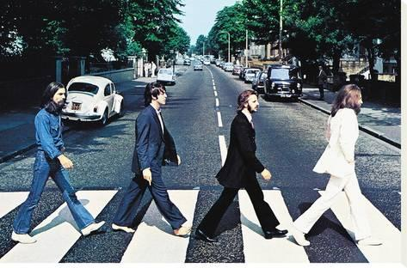
Get what in a row?
Your line of logic
What do we know?
What is the gap?
Why can you fill the gap?
How will you fill the gap?
How will that change what we know?

Slide 6
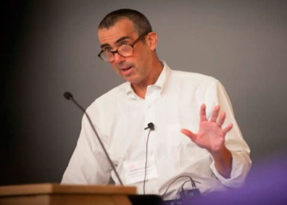
Why would I want to do that?
Helps to keep the bigger picture in mind
Avoids doing things that are pointless / have been done before
Avoids ‘kitchen sink’ experiments (often uninterpretable)
Helps you to choose the right controls
Jon Yewdell, NIH
“What is the most exciting thing that could happen?”

Slide 7
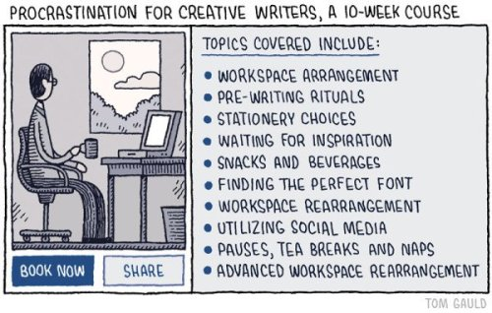
So when do I really start?
Now!
● DOING ANOTHER EXPERIMENT

Slide 8
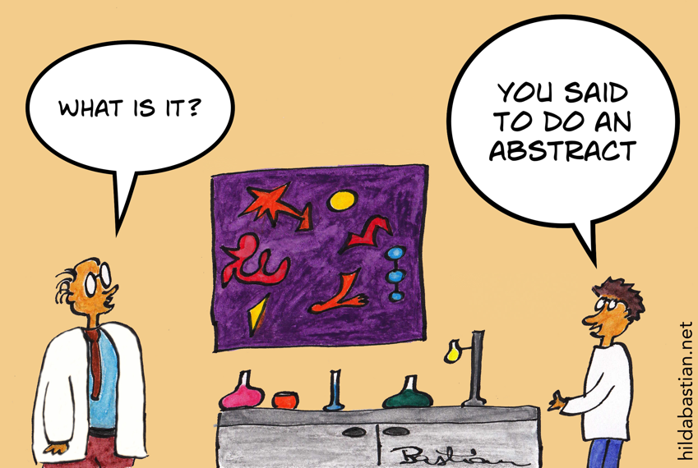
Where do you start?
CD8⁺ T cell immunodominance

Slide 9
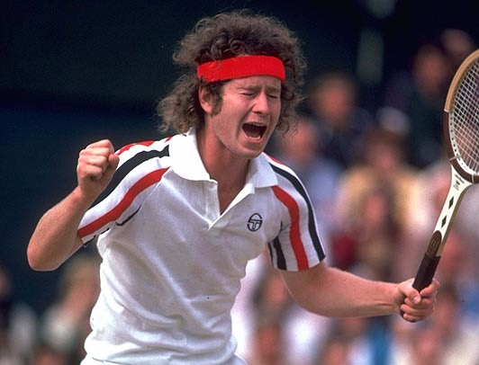
You cannot be serious

Slide 10

Starting with the abstract…
Gets your story clear in your head
Helps focus on
The essential background
Your key findings
What you want to say
  Generally one main message
Are there gaps in your line of logic?

Slide 11
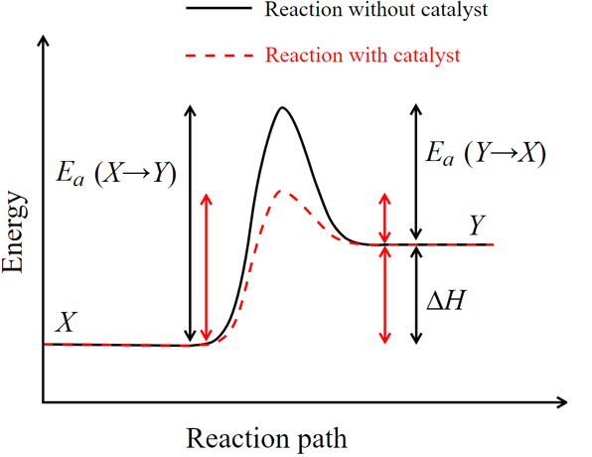
But everyone starts by making figures
Yep, it sure beats writing!

Slide 12
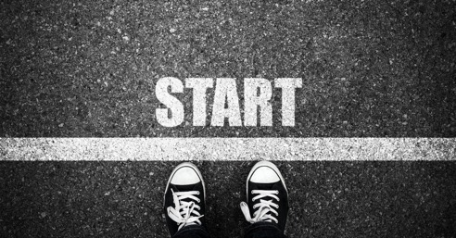
But everyone starts by making figures
BUT if you are thinking about the paper all the time
The way you prepare your data from the outset looks like a set of figures
It is more important to clarify your main message

Slide 13

An abstract might be easier than you think
Have you submitted an abstract to a meeting?
  It’s not so different
  You probably already have some supervisory input
Then you have started

Slide 14
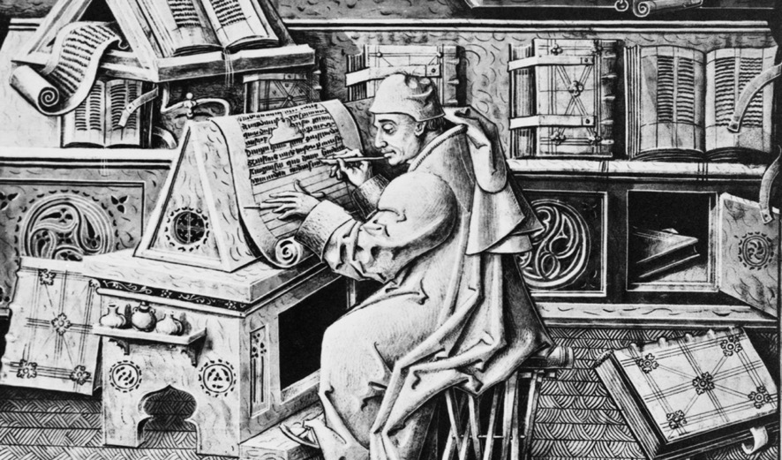
Now that you are writing…

Slide 15

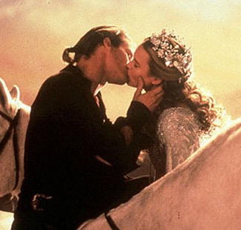
Rule #1
Remember the KISS rule
Keep it Simple, Stupid

Slide 16
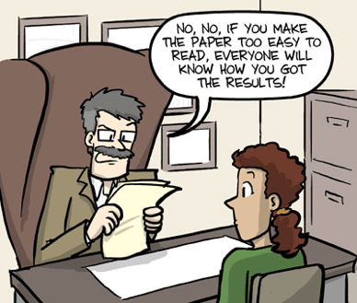
Simple writing leads to clarity of expression
CD8⁺ T cell immunodominance
When you learnt to write (in school)
You are encouraged to write with flair
  Ambiguity is OK and can enhance reading in fiction
When writing science
Absolute clarity comes first
When reviewers ‘don’t get it’ it can be because you are not being clear because of:
Assumptions
Ambiguity in your writing
Too many messages
Experiments not explained

Slide 17
Don’t assume that your rationale is obvious!
Your reviewer and the readers
Don’t go to your lab meetings
They didn’t come out of your lab
Don’t know all the stuff you know
Have not been on the journey with you
Do not know how the story ends
So they do not necessarily
Have the same assumptions
Know your models and experimental approaches
Know why you are doing what you are doing
You need to lay out the rationale

Slide 18
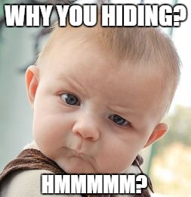
Less ambiguity, more accuracy
CD8⁺ T cell immunodominance
For example
“the majority of the time”- could be:
  “90% of the time”
  “75% of the time”
  “51% of the time”
Not using the numbers might lead to suspicion

Slide 19
If you get bogged down with too much to say
Make a list of all the details you can think of
Rank them
Draw a line at some point down the list
The rule is that you are not allowed to include anything about the details under the line until you have a complete draft
The key is (of course) where you draw the line
  First go down and make a line above the first non-essential item
  If you still have too much stuff above your line, move it up so that you remove the bottom third or half
  Be lean to focus on the important stuff
You can add things later

Slide 20
Use figures to help explain complex experiments

Slide 21
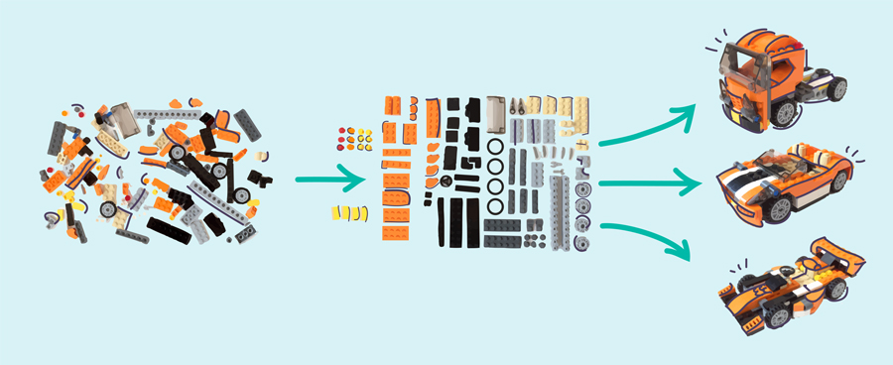
Rule #2 Structure is key

Slide 22
A scientific writing structure
The view in the field is…
This is because of experimental results…
However this does not account for…
  Or - However this does not apply to…
  Or - However to apply this knowledge…
We think that…
This can be tested by…
So we did that and found…
Putting our data with the literature suggests…

Slide 23
General paragraph structure
Topic Sentence - the beginning
  Needs to state ONE idea clearly
Supporting Sentences - the middle
  Elaborates
  Evidence and examples
  Explains
Concluding Sentence - the end
  Makes links
Do not confuse the topic sentence with your conclusion or interpretation.
Conclusions come after evidence

Slide 24
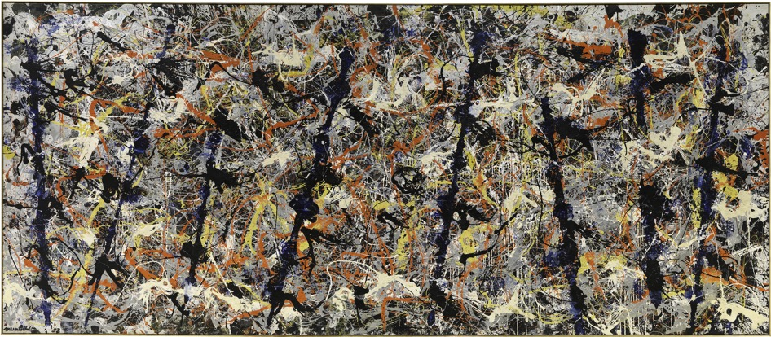
If you get lost
CD8⁺ T cell immunodominance
Go back to your abstract

Slide 25

Rule #3 You are writing a story

Slide 26
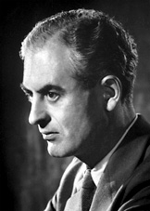
But not the actual story…
Peter Medawar
Nobel prize in physiology and medicine, 1960
“… a totally misleading narrative of the processes of thought that go into the making of scientific discoveries”
Is the Scientific Paper a Fraud?
http://nobelprize.org

Slide 27
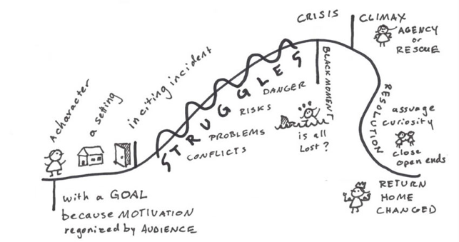
Not a chronologically accurate story, but…
A story has a shape
The story guides readers through the data
  Explains the ‘why’ for each experiment
Requires internal consistency
  You have lived it all. Your audience reads from start to end.
Writing devices like suspence keep the reader engaged
DO:
Think about your emerging story with each experiment
DON’T:
Get trapped by your emotional attachment to the work

Slide 28
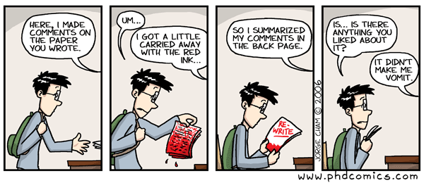
Dealing with your supervisor/mentor
You’ve been thinking about it from the beginning…
Get on the front foot - bring your ideas and take notes
Where to send it
What’s in and what’s out
You could pitch your abstract
Discuss practicalities (timing, author lists, etc)
What help do you need?

Slide 29
What does your supervisor/mentor want?
This supervisor/mentor likes a whole paper!
Title
  Preferably a full title page
Abstract
Introduction
Results
  With figures formatted close to what a journal needs
Methods
Discussion
Acknowledgements (as best you can)
References
Yes, I mean everything!
  And according to the requirements of the journal

Slide 30
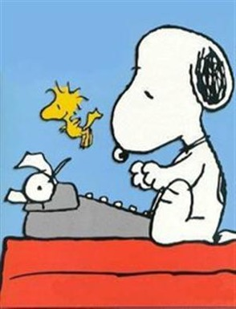
Be kind to yourself
Writing science is hard
No one has taught you
  Science writing is an art in itself
  It is a creative process
You want to do justice to the work
  And your collaborators
You are emotionally invested
You are sticking your neck out
  You will get feedback!
You have to find your own voice

Slide 31
Peer review can be brutal (to us all)
2002
“…the study does not provide new insights, lead to new concepts, or address any new hypothesis…”
2007
“Despite having only a single figure the manuscript is difficult to follow!”
2013
“So the reviewer is left with these negative results without any insight…”
2019
“… the manuscript presents nothing other than an unexplained correlative phenomenon.”

Slide 32
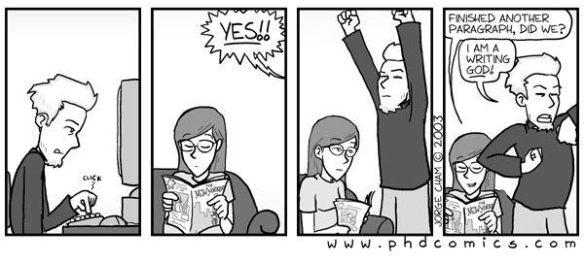
When you get something finished
Celebrate your achievement

