Slide 1
Predatory publishing: how to save yourselves from the bad guys
ANU Library

Slide 2
What is predatory publishing?
…predatory publishers…publish counterfeit journals to exploit the open-access model in which the author pays. These predatory publishers are dishonest and lack transparency. They aim to dupe researchers, especially those inexperienced in scholarly communication.
Beall, J. (2012) “Predatory publishers are corrupting open access”, Nature, vol. 489 iss. 7415. http://www.nature.com/news/predatory-publishers-are-corrupting-open-access-1.11385

Slide 3
What should an academic or researcher expect from publishing?
Contribution to your reputation
Visibility to a professional community
Record of research
Recognition of quality work
Peer review

Slide 4
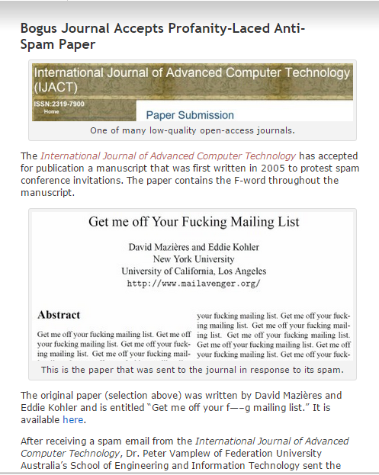
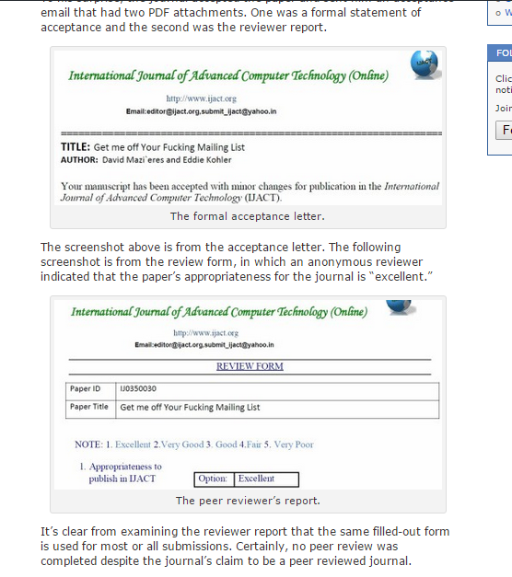
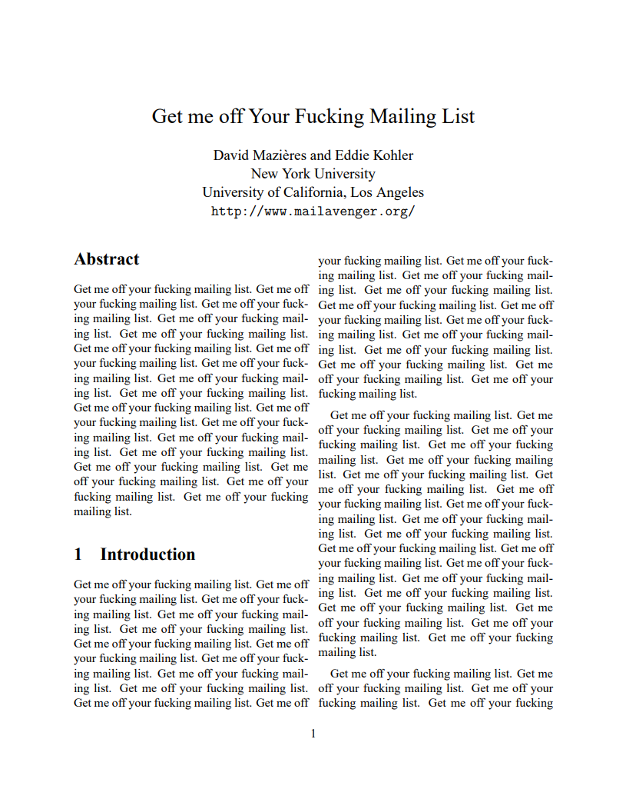
News
Yes really

Slide 6
3 top tips
If you haven’t heard of the journal or conference check tools such as Incites, Beall’s list or ask your local librarian
Don’t believe the web site – ask your colleagues and look at indicators of journal impact. Our guide Journal measures and tools can help you
Don’t respond to unsolicited emails – choose the journals you wish to submit to.

Slide 7
Varieties of predatory publishing
Phony Journals (e.g. Australasian Journal of Bone and Joint Medicine, which was published by Elsevier)
Pseudo-scholarly Journals (claim peer review and impact factors)
False-flag Journals (sneaky)
Masqueraders
Anderson, R. (2015) “Deceptive Publishing: Why We Need a Blacklist, and Some Suggestions on How to Do It Right” http://scholarlykitchen.sspnet.org/2015/08/17/deceptive-publishing-why-we-need-a-blacklist-and-some-suggestions-on-how-to-do-it-right/

Slide 8
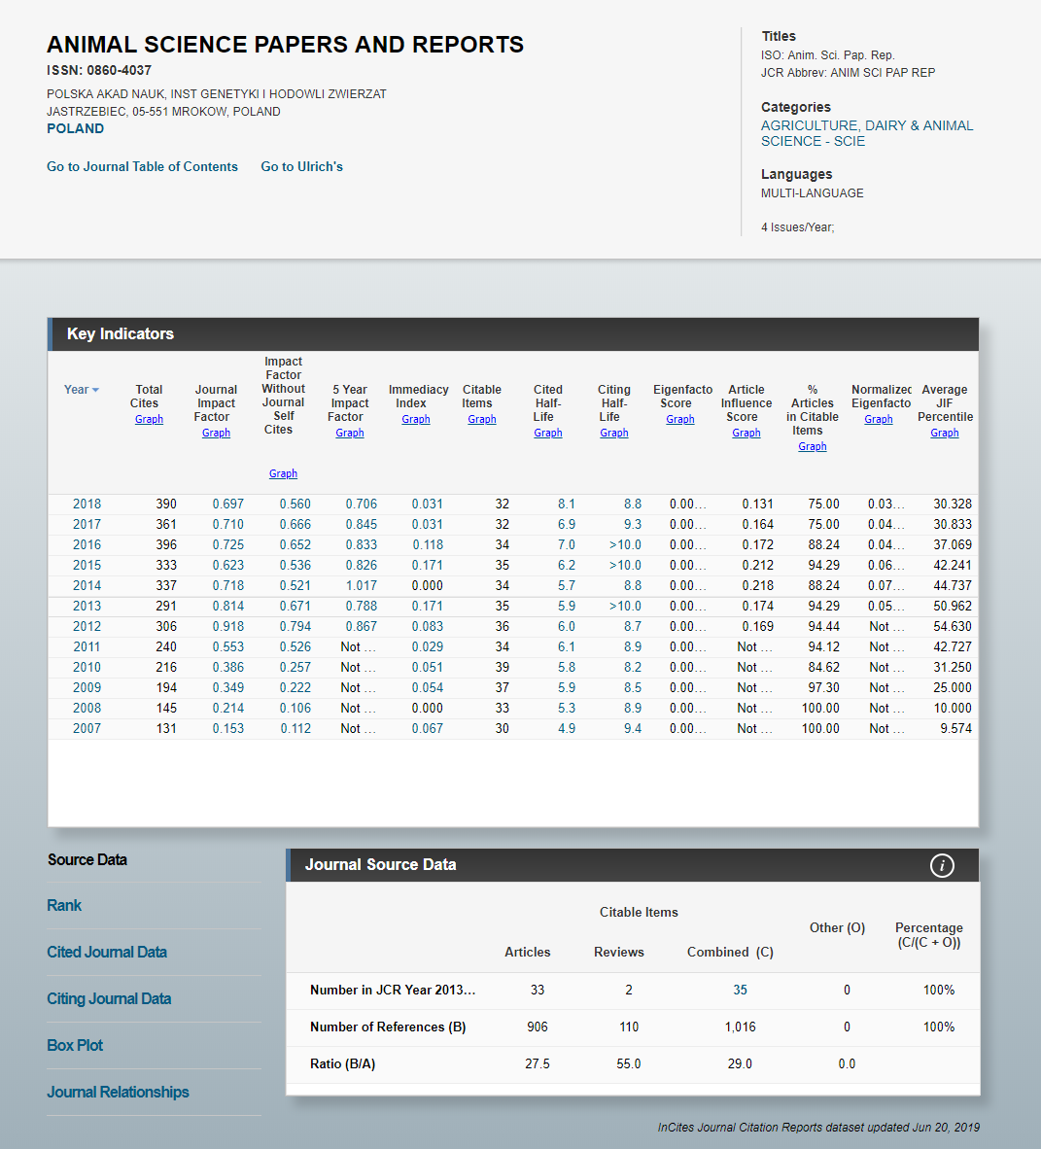
On line tools
Incites

Slide 9
Criteria
Beall’s Criteria for Determining Predatory Open-Access Publishers
Committee on Publishing Ethics:
Code of Conduct for Journal Publishers
Principles of Transparency and Best Practice in Scholarly Publishing
Quality editorial board (note this can be circumvented by predatory publishers)

Slide 10
Not just open access publishers
Springer and IEEE removed more than 120 papers after Cyril Labbé of Joseph Fourier University in Grenoble, France, discovered computer-generated papers published in their journals.

Slide 12
Predatory publishers
Can devalue your publishing record
Can restrict you from publishing in good quality journals (because of the licence you agree to)

Slide 13
Keeping up to date
Follow Australasian Open Access Support Group
https://thinkchecksubmit.org/
Notes:
http://www.nature.com/news/the-top-100-papers-1.16224

Slide 14
Your feedback/comments

